Slide 1
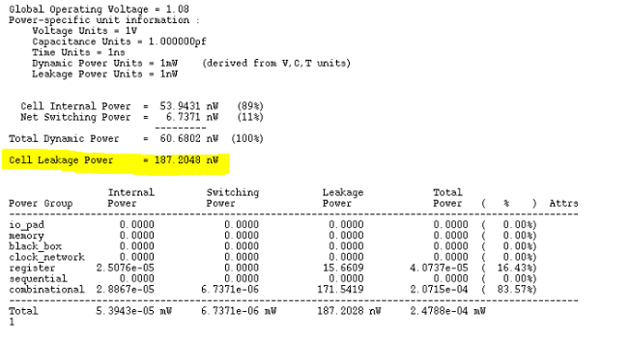
14. A 510nW, 0.41V Low-Memory, Low-Computation Keyword Spotting Chip using Serial FFT based MFCC and Binarized Depthwise Separable Convolutional Neural Network in 28nm CMOS (2020 ISSCC)
Power of 10bit-multipler
187.2048 nw

Slide 2
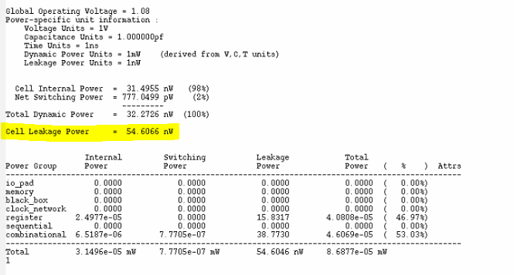
14. A 510nW, 0.41V Low-Memory, Low-Computation Keyword Spotting Chip using Serial FFT based MFCC and Binarized Depthwise Separable Convolutional Neural Network in 28nm CMOS (2020 ISSCC)
Power of 10bit-adder
54.6066 nw

Slide 3
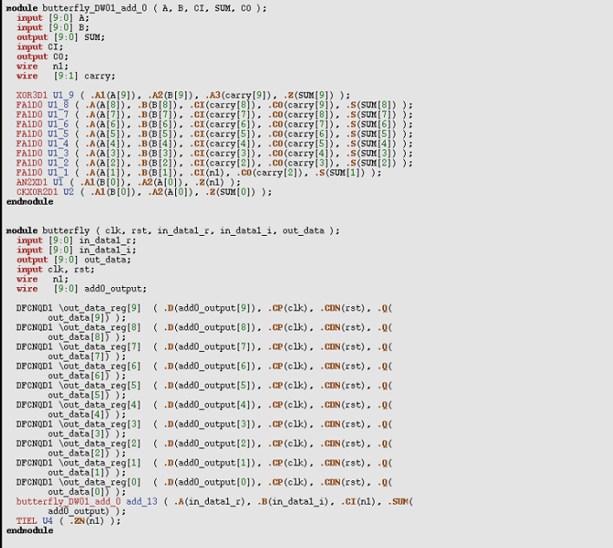
14. A 510nW, 0.41V Low-Memory, Low-Computation Keyword Spotting Chip using Serial FFT based MFCC and Binarized Depthwise Separable Convolutional Neural Network in 28nm CMOS (2020 ISSCC)
Verilog of 10bit-adder
XOR3D1 * 1
FA1D0 * 8
AN2XD1 * 1
CKXOR2D1 * 1
DFCNQD1 * 10

Slide 4

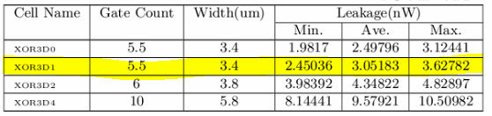
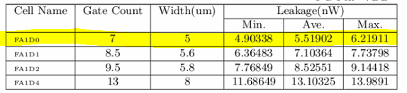
14. A 510nW, 0.41V Low-Memory, Low-Computation Keyword Spotting Chip using Serial FFT based MFCC and Binarized Depthwise Separable Convolutional Neural Network in 28nm CMOS (2020 ISSCC)
XOR3D1
FA1D0

Slide 5
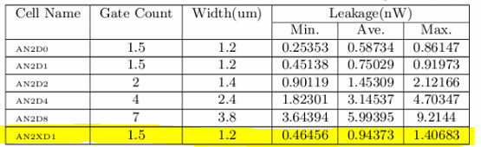
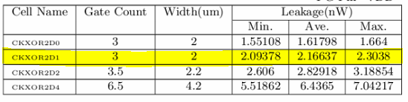
14. A 510nW, 0.41V Low-Memory, Low-Computation Keyword Spotting Chip using Serial FFT based MFCC and Binarized Depthwise Separable Convolutional Neural Network in 28nm CMOS (2020 ISSCC)
AN2XD1
CKXOR2D1

Slide 6
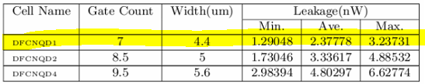
14. A 510nW, 0.41V Low-Memory, Low-Computation Keyword Spotting Chip using Serial FFT based MFCC and Binarized Depthwise Separable Convolutional Neural Network in 28nm CMOS (2020 ISSCC)
DFCNQD1

Slide 7
14. A 510nW, 0.41V Low-Memory, Low-Computation Keyword Spotting Chip using Serial FFT based MFCC and Binarized Depthwise Separable Convolutional Neural Network in 28nm CMOS (2020 ISSCC)
Power of 10bit-adder by TSMC libraries (average leakage power)
3.05183 *1 + 5.51902 *8 + 0.94373 *1 + 2.16637 *1 + 2.37778 *10
= 74.09189 nw
Power of 10bit-adder by TSMC libraries (min leakage power)
2.45036 *1 + 4.90338 *8 + 0.46456 *1 + 2.09378 *1 + 1.29048 *10
= 57.14054 nw
Power of 10bit-adder by TSMC libraries (max leakage power)
3.62782 *1 + 6.21911 *8 + 1.40683 *1 + 2.3038 *1 + 3.23731 *10
= 89.46443 nw

Slide 8
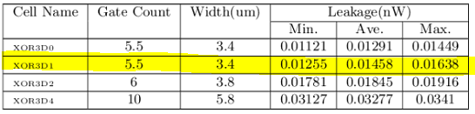
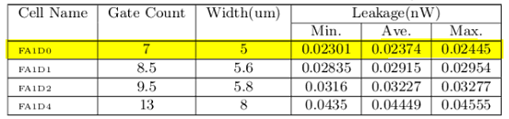
14. A 510nW, 0.41V Low-Memory, Low-Computation Keyword Spotting Chip using Serial FFT based MFCC and Binarized Depthwise Separable Convolutional Neural Network in 28nm CMOS (2020 ISSCC)
XOR3D1
FA1D0

Slide 9
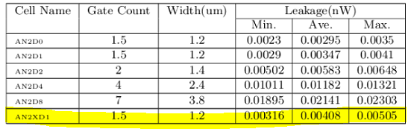
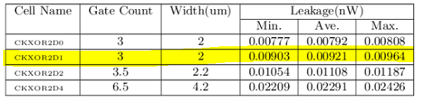
14. A 510nW, 0.41V Low-Memory, Low-Computation Keyword Spotting Chip using Serial FFT based MFCC and Binarized Depthwise Separable Convolutional Neural Network in 28nm CMOS (2020 ISSCC)
AN2XD1
CKXOR2D1

Slide 10
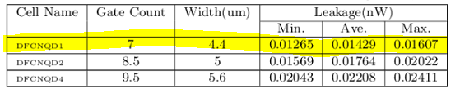
14. A 510nW, 0.41V Low-Memory, Low-Computation Keyword Spotting Chip using Serial FFT based MFCC and Binarized Depthwise Separable Convolutional Neural Network in 28nm CMOS (2020 ISSCC)
DFCNQD1

Slide 11
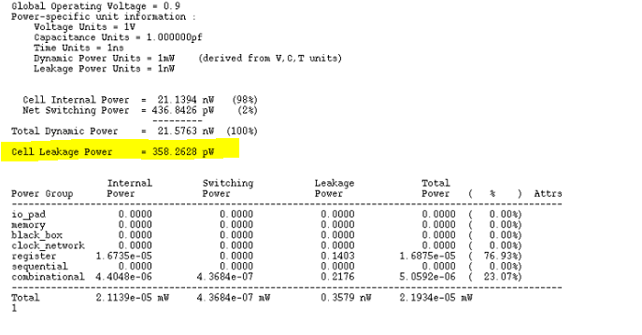
14. A 510nW, 0.41V Low-Memory, Low-Computation Keyword Spotting Chip using Serial FFT based MFCC and Binarized Depthwise Separable Convolutional Neural Network in 28nm CMOS (2020 ISSCC)
Power of 10bit-adder
54.6066 nw -> 358.2628pw

Slide 12
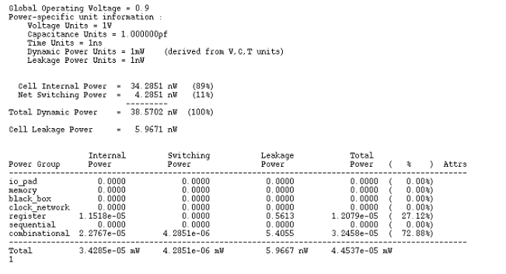
14. A 510nW, 0.41V Low-Memory, Low-Computation Keyword Spotting Chip using Serial FFT based MFCC and Binarized Depthwise Separable Convolutional Neural Network in 28nm CMOS (2020 ISSCC)
Power of 10bit-MFCC-compute-module
1.0510 uw -> 44.537 nw

Slide 13
15. MFCC hardware design
1. Have one butterfly module to calculate fft, and other modules to calculate other operations, such like mel-filter, DCT…
+
Butterfly module
-
x
1 frame input signals
+
-
Mfcc feature
-
x
Mel_filter module
DCT
module
-
+
+
x
-

Slide 14
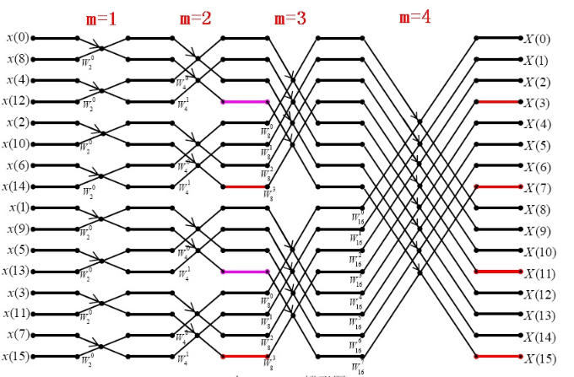
15. MFCC hardware design
1. Have one butterfly module to calculate fft, and other modules to calculate other operations, such like mel-filter, DCT…
To calculate 256 input real FFT,
1 butterfly module will cost:
64 * 7 = 448 clk
1_1
2_1
4_1
1_2
2_2
4_2
1_8
2_8
4_8

Slide 15
15. MFCC hardware design
2. Have one MFCC compute module, resuing it to calculate all MFCC’s operations.
+
MFCC module
-
x
1 frame input signals
+
-
Mfcc feature
-
x
-
+
+
x
-
Compare to design1,
design 2 will cost two times clk because of hardware reusing;
And need more mux in hardware and more complicated control module;
And Reduce memory of middle data.

Slide 16
15. MFCC hardware design
3. Using parallel butterfly module (bit-serial) to calculate FFT, other module to calculate other opertions.
+
butterfly module #1
-
x
+
-
-
x
Mel_filter module
DCT
module
Mfcc feature
-
+
1 frame input signals
+
x
-
.
.
.
Calculate 256 real fft will cost:
8(bit-width) * 7 = 56 clk
butterfly module #7
butterfly module #8

Slide 17
15. MFCC hardware design
3. Using parallel butterfly module (bit-serial) to calculate FFT, other module to calculate other opertions.
calculate 256 input real FFT will cost:
8(bit width) * 7 = 56 clk
1
2
4

